Slide 1
Image Type Classification

Slide 2
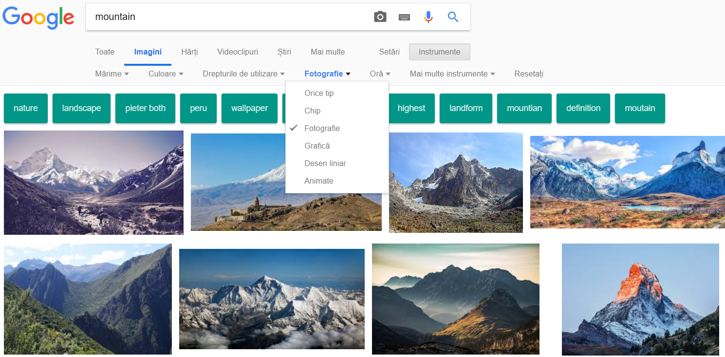
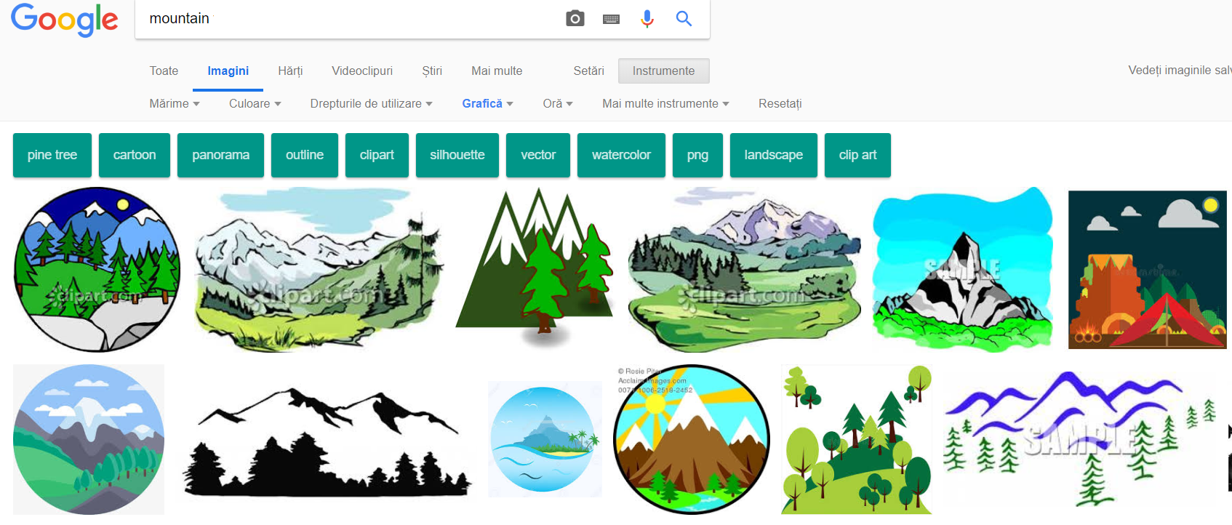
Acquisition of the database
I have developed a python script that downloaded almost 25,000 from Google
Images (illustrations and photography documents)

Slide 3
Tested algorithms
I have implemented three different solutions for this problem
(all of these using Machine Learning and Image processing approaches):
1. Standard color and texture features in combination with machine learning algorithms;
2. Local feature extraction and aggregation with Support Vector Machines;
3. Convolutional Deep learning architecture;

Slide 4
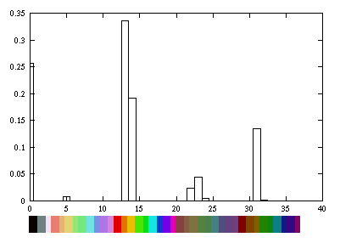

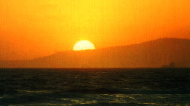

1. Standard image features
HSV Image Histogram
The color histogram of an image defines the image color distribution;
HSV is used because is easier to describe colors from the human perspective.
Transform image from RGB to HSV
Quantize the image
Notes:
The color histogram of an image defines the image color distribution.
The reason of using the color images is that illustrations and photos may have different color distributions.
HSV is used because is easier to describe colors from the human perspective (very used in Computer vision together with CIE-LAB color space)

Slide 5
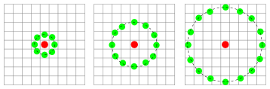
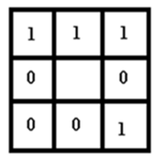
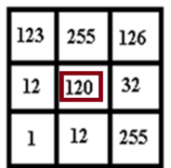
1. Standard image features
Locally Binary Patterns (LBP)
Divide the examined window to cells (e.g. 16x16 pixels for each cell).
For each pixel in a cell, compare the pixel to each of its 8 neighbors (on its left-top, left-middle, left-bottom, right-top, etc.). Follow the pixels along a circle, i.e. clockwise or counter-clockwise.

Slide 6
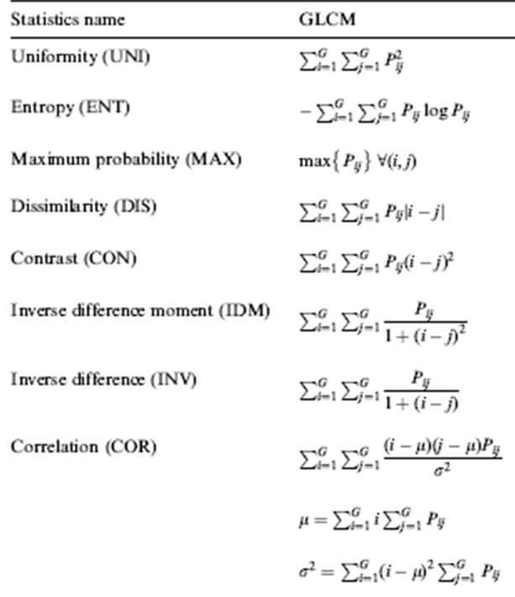
1. Standard image features
Gray Level Co-occurrence Matrix Gray Level (GLCM)
GLCM is a matrix that contains how often different combinations of gray levels co-occur in an image or image section:
Quantize the image data
Create the GLCM: It will be a square matrix N x N in size where N is the Number of levels specified under Quantization
Calculate the selected features (e.g., Energy, Entropy, Contrast, Homogeneity, Correlation, Shade or Prominence)

Slide 7
1. Standard image features
Machine learning models
Support Vector Machines
Random Forests
Gradient Boosting Classifier

Slide 8
1. Support vector machines
Support vectors
Class 2
The hyperplane is chosen where the distance between distinct categories is maximized.
Maximizes margin
Class 1

Slide 9
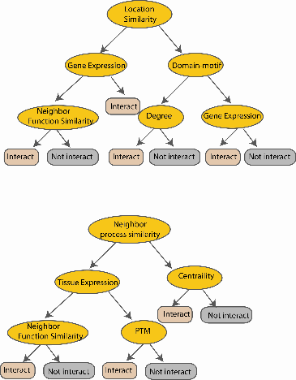
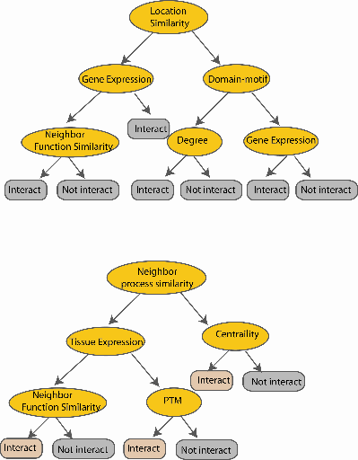
1. Bagging algorithms - Random forests
Class 2
M features
N examples
Random Patches samples both the training Instances as well as the Features.
Random Subspaces keeps all the instances but samples features.
....…
....…
Class 1
Take the majority vote
Bagging method – the trees are running in parallel
(there is no interaction between them)

Slide 10
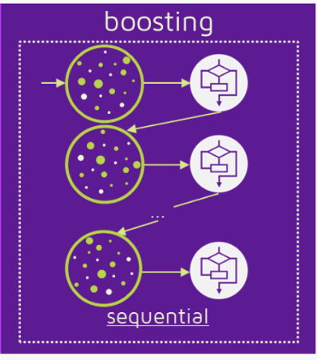
1. Boosting algorithms – Gradient Boosted trees
Training Sample
h₁
Weighted Sample
h₂
H
…
Weighted Sample
h_{T}
Bagging method – the trees are running in sequentially
(there is interaction between them)

Slide 11

1. Combining more algorithms together
Late Fusion
Descriptor
Classifier 1
Confidence value 1
(normalized)
Classifier 2
Confidence value 2
(normalized)
Decision
Descriptor
Global Confidence
score
Descriptor
Classifier n
Confidence value n
(normalized)
Feature extraction
Classification Step
Confidence Scores Normalization
Global Confidence Score
Hard voting vs Soft Voting

Slide 12
1. Results
Individual results
 | SVM Liniar | Non Linear SVM | Random forests | Gradient Boosting
HSV Histogram | 92.10 | 93.19 | 93.86 | 92.84
LBP | 91.51 | 92.97 | 93.39 | 92.86
GLCM | 93.02 | 93.14 | 92.82 | 92.94
Late fusion results
 | Accuracy
Maximum | 93.92
Average | 94.41
Hard voting | 93.91

Slide 13
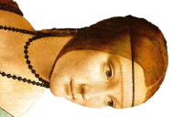
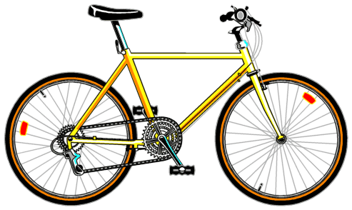
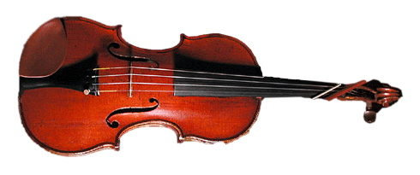
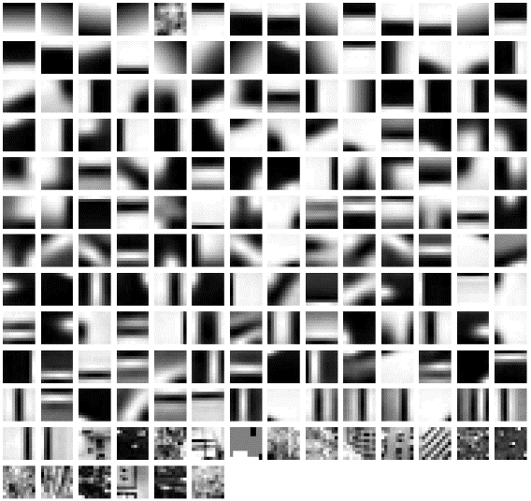
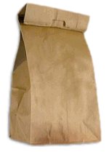









2. Bag of Words
Learning
Recognition
Word dictionary
Keypoints extraction
Image representation
SVM training
decision

Slide 14
2. Results
Size of the visual words dictionary was set to 1024
 | SVM Liniar | Non Linear SVM | Random forests | Gradient Boosting
Bag of Words with SIFT | 89.35 | 87.68 | 87.42 | 87.94
Bag of Words with SURF | 92.07 | 90.83 | 90.51 | 89.61

Slide 15
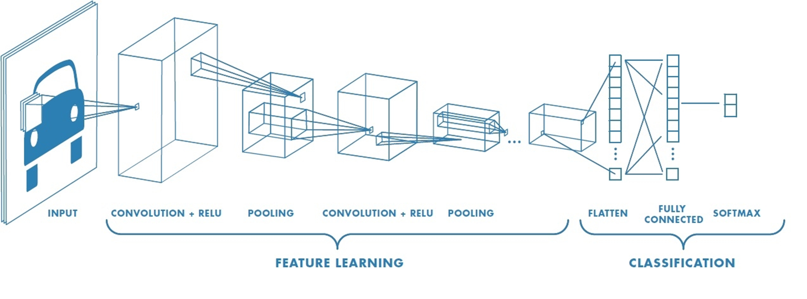
3. Convolutional Neural Network

Slide 16
3. Results
Architecture | Accuracy
One convolutional layer 5x5 with Flatten and Softmax | 91.70
Two convolutional layer 5x5, MaxPooling, Flatten and Softmax | 91.18
Two convolutional layer 5x5, MaxPooling, Dropout, Flatten and Softmax | 92.72
Two convolutional layer 5x5, MaxPooling, Dropout, Flatten, Relu + Dropout and Softmax | 93.35

Slide 17






What I used?

Slide 18


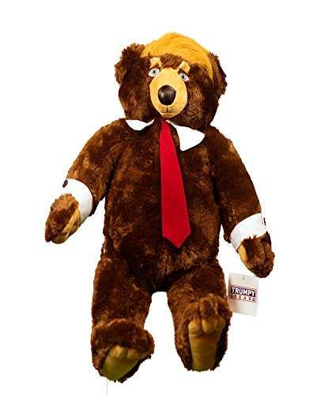
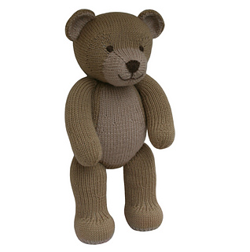
Example of results - illustrations
GLCM - 0.995
HSV Histogram - 0.995
LBP - 0.985
BOW SIFT 0.9953
CNN 0.9999
GLCM 0.965
HSV Histogram 0.995
LBP 0.995
BOW SIFT 0.9668
CNN 0.9918
GLCM 0.91
HSV Histogram 0.985
LBP 0.912
BOW SIFT 0.890
CNN 0.9859
GLCM 0.945
HSV Histogram 0.87
LBP 0.895
BOW SIFT 0.9406
CNN 0.92685
Each value represents the confidence on the provided prediction.
The values are in the interval [0, 1]

Slide 19
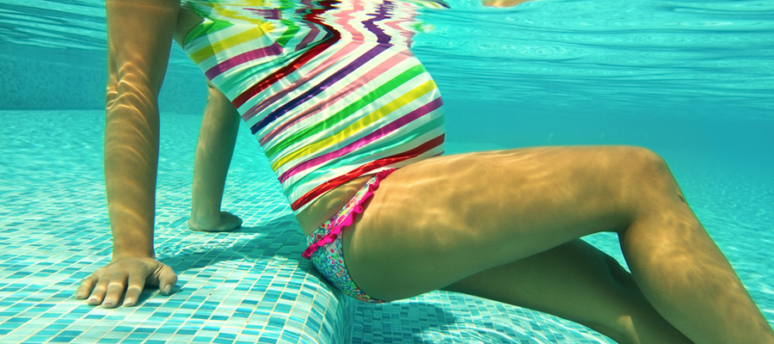
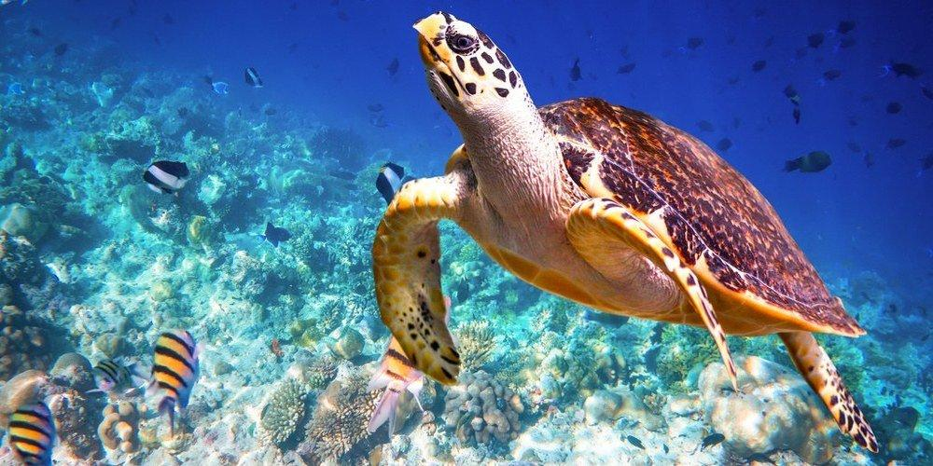
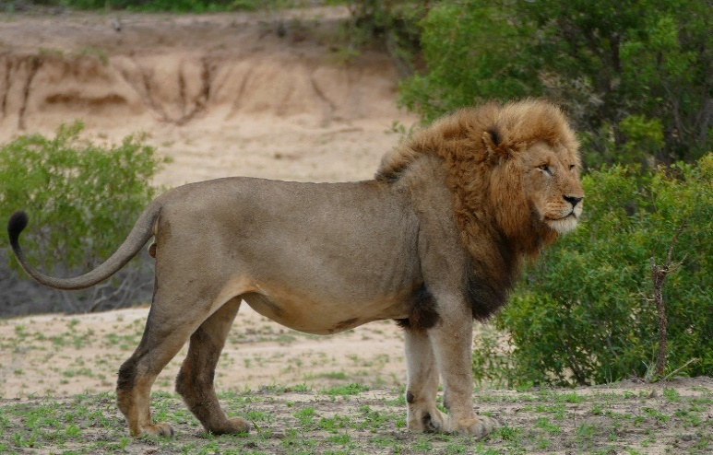
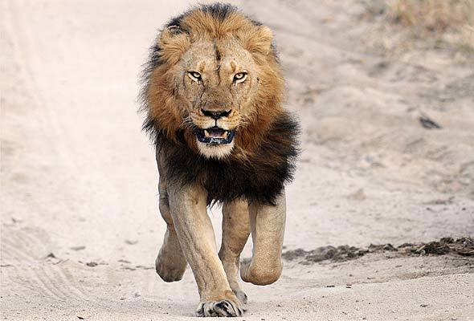
Example of results - Photos
GLCM 1.0
HSV Histogram 0.82
LBP 1.0
BOW SIFT 0.8868
CNN 1.0
GLCM 1.0]
HSV Histogram 0.975
LBP 0.995
BOW SIFT 0.9509
CNN 1.0
GLCM 1. 0
HSV Histogram 1. 0
LBP 1. 0
BOW SIFT 0.9687
CNN 1.0
GLCM 1. 0
HSV Histogram 0.855
LBP 1. 0
BOW SIFT 0.9069
CNN 1.0
Each value represents the confidence on the provided prediction.
The values are in the interval [0, 1]

Slide 20




Thank you
Ionuț Mironică
ionut.mironica
ionut.mironica
http://ionut.mironica.ro
imironica

